Slide 1

Google Cloud Associate Engineer

Slide 2
Associate Cloud Engineer
Good to have basic IT skill, but I will start from scratch in GCP
Learn by Doing
So with every exam objective, There is hand-on Lab
Create GCP free tier account

Slide 3
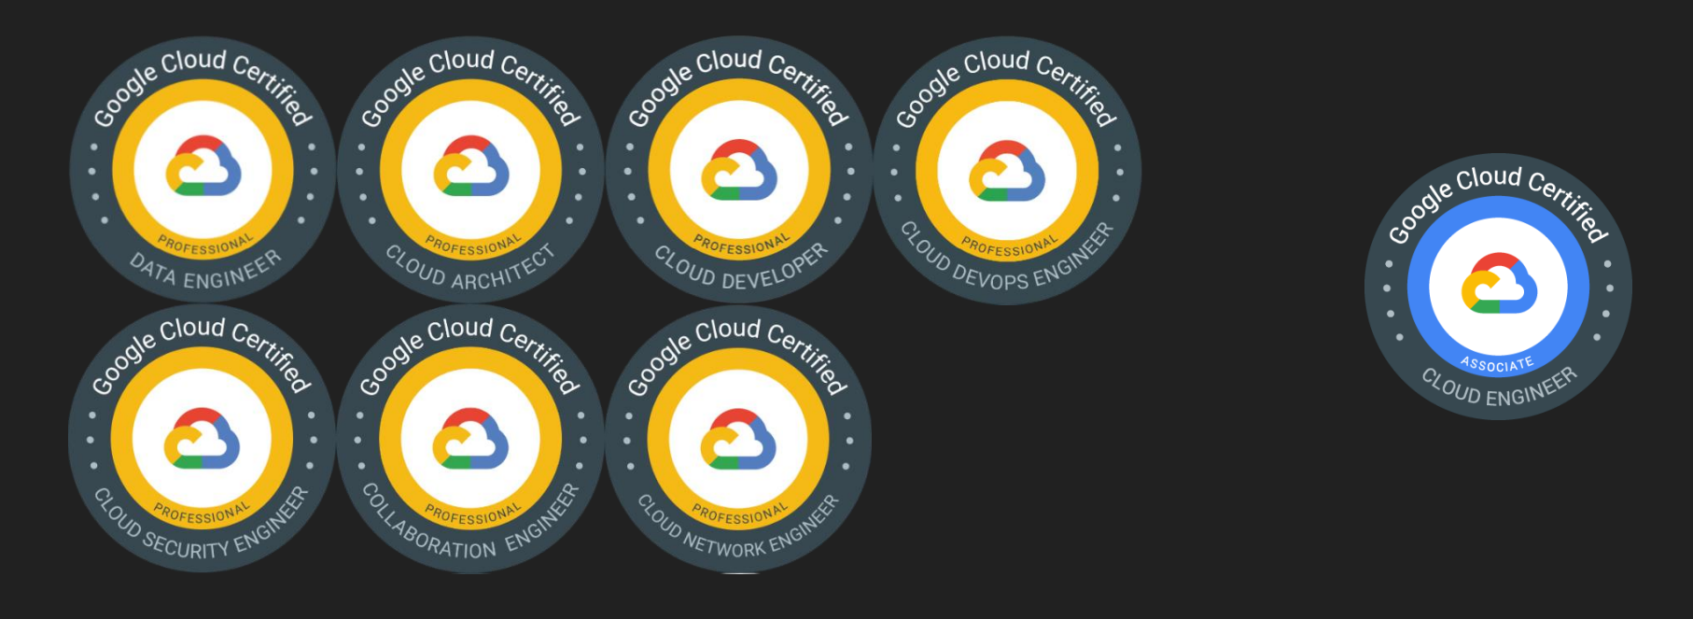
GCP certifications
https://cloud.google.com/certification/guides/cloud-engineer

Slide 4
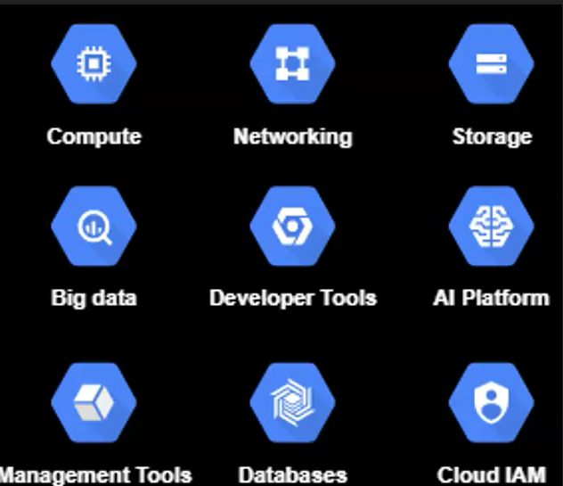
What is GCP
Google Cloud Platform – Suite of Cloud computing services offered by Google
Offers 200+ services
https://cloud.google.com/
GCP is a public cloud service provider

Slide 5
Why GCP
➢ Trust & Security
Trust nothing by default
➢ Open Cloud Platform (Open API)
➢ https://cloud.google.com/open-cloud
➢ Global Network Infrastructure
https://cloud.google.com/about/locations#network
➢ AI Driven Cloud
https://cloud.google.com/products/ai

Slide 6
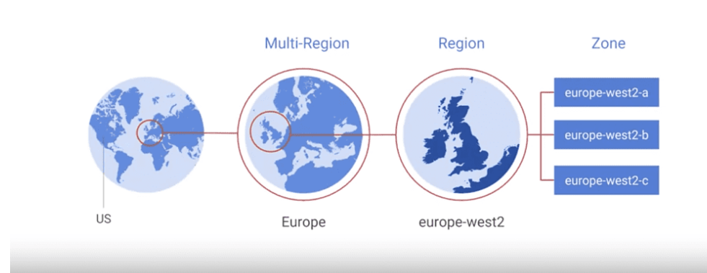
GCP Regions & Zones
Region – Geographical area – 36 Regions
Zones – Independent data Center – 109 Zones
Multi-region : Collection of Geographical
Global – Anywhere – 200+ Countries and territories
https://cloud.google.com/about/locations

Slide 7
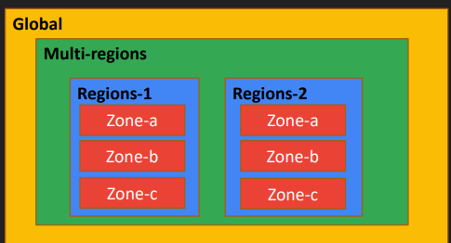
Why Zones & Regions
➢ Low latency
➢ Follow Government rules
➢ High availability
➢ Disaster recovery

Slide 8
Selecting Regions and Zones
Distance: Choose zones based on the location of your customers
Communication: Communication between regions incur higher cost as compare to communication within same region
Redundant Systems: should design any important systems with redundancy across multiple regions and zones
Resource Distribution: Zones are independent of one another so if one zone fails or becomes unavailable, you can transfer traffic to another zone in the same region
Cost/Pricing: You should always check the pricing to compare the cost between regions

